Slide 1
EEG denoising

Slide 2
Problem
Removing artifacts from EEG signals with minimum distortion and contamination
enhance the BCI performance
increase the accuracy of data interpretation
enhance classification models performance

Slide 3
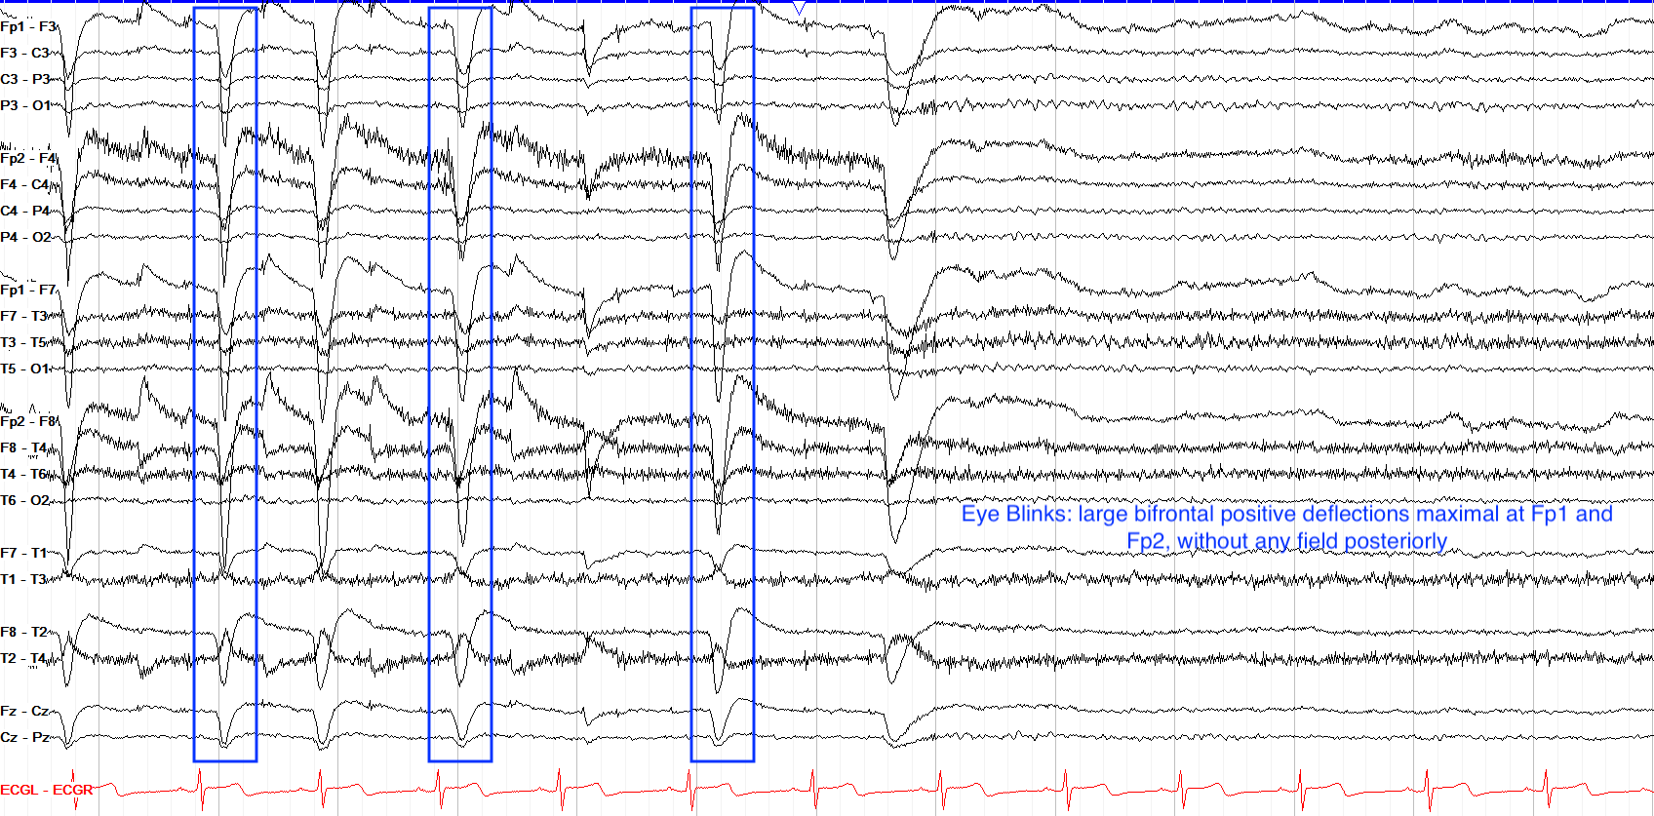
Types of artifacts
Eye blinks
https://www.learningeeg.com/artifacts

Slide 4
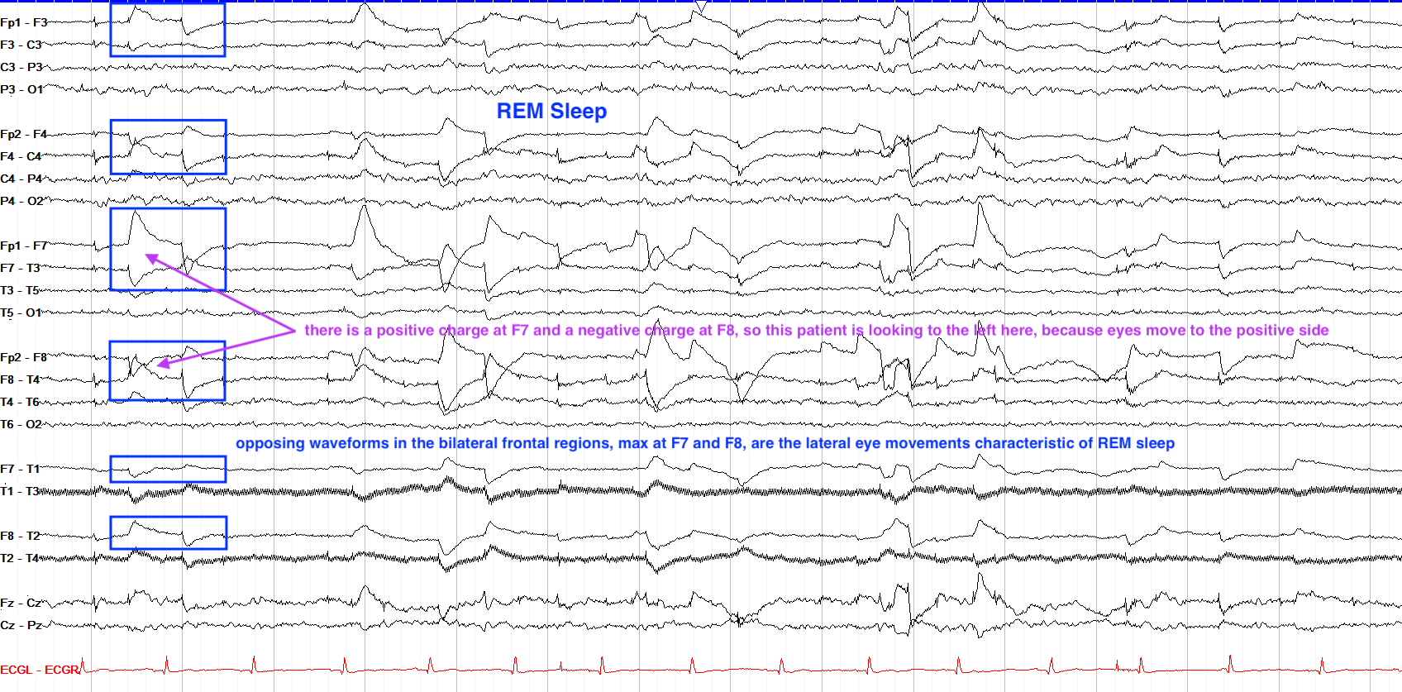
Types of artifacts
Eye blinks
Lateral eye movements
https://www.learningeeg.com/artifacts

Slide 5
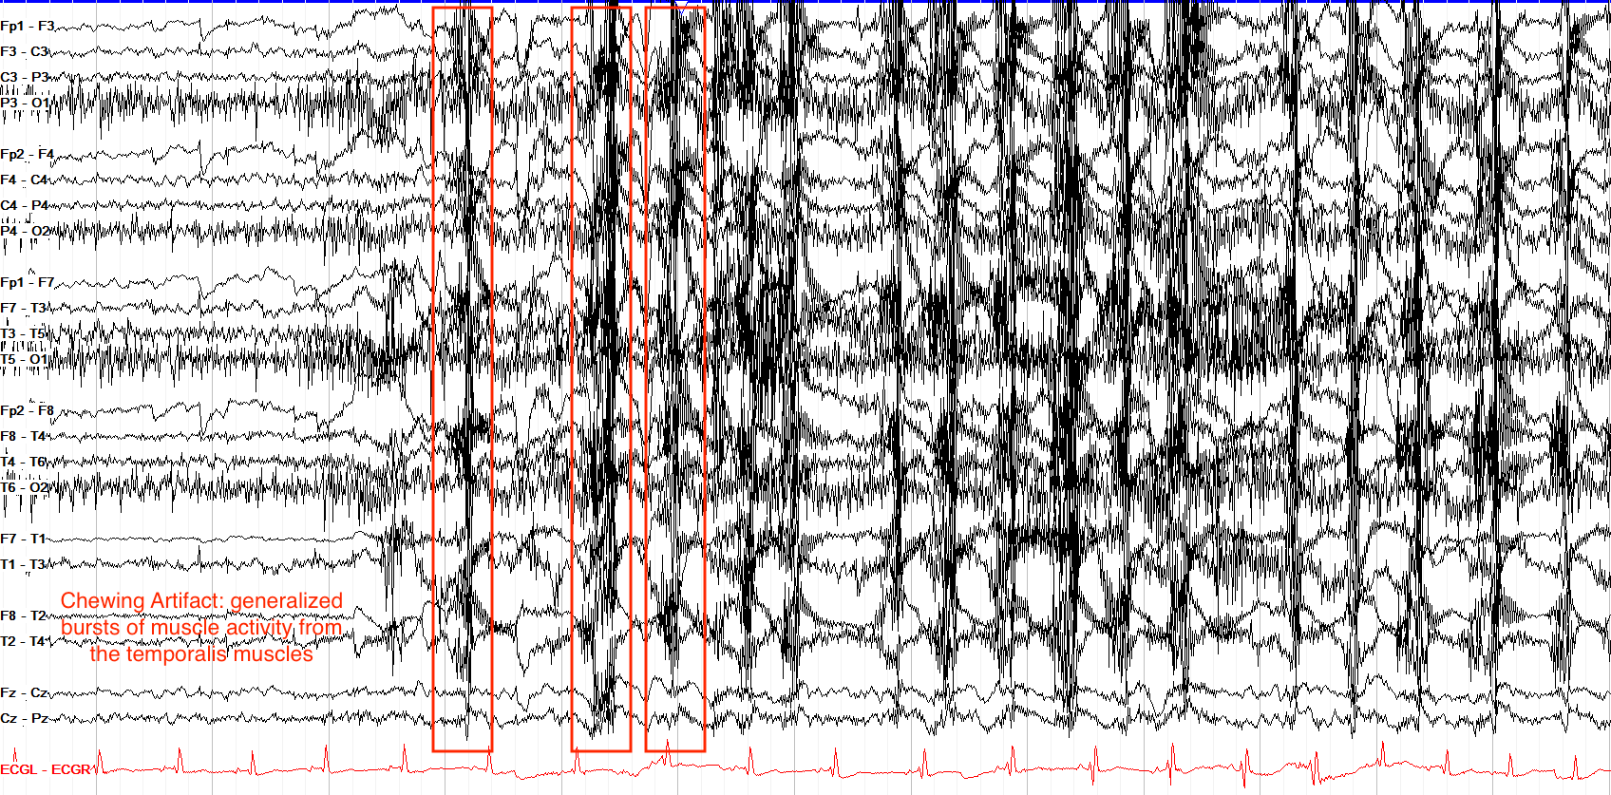
Types of artifacts
Eye blinks
Lateral eye movements
Chewing and tongue artifact
https://www.learningeeg.com/artifacts

Slide 6
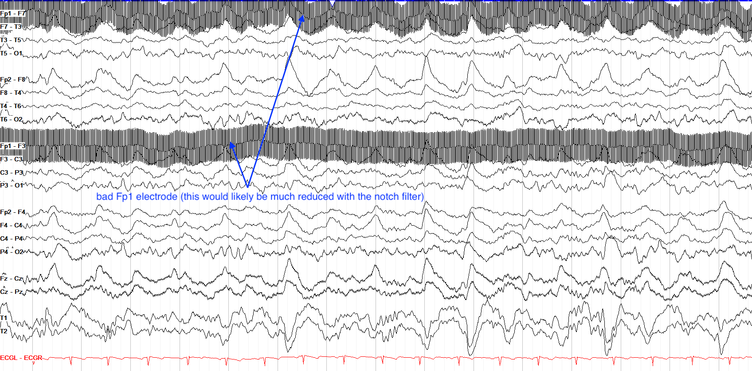
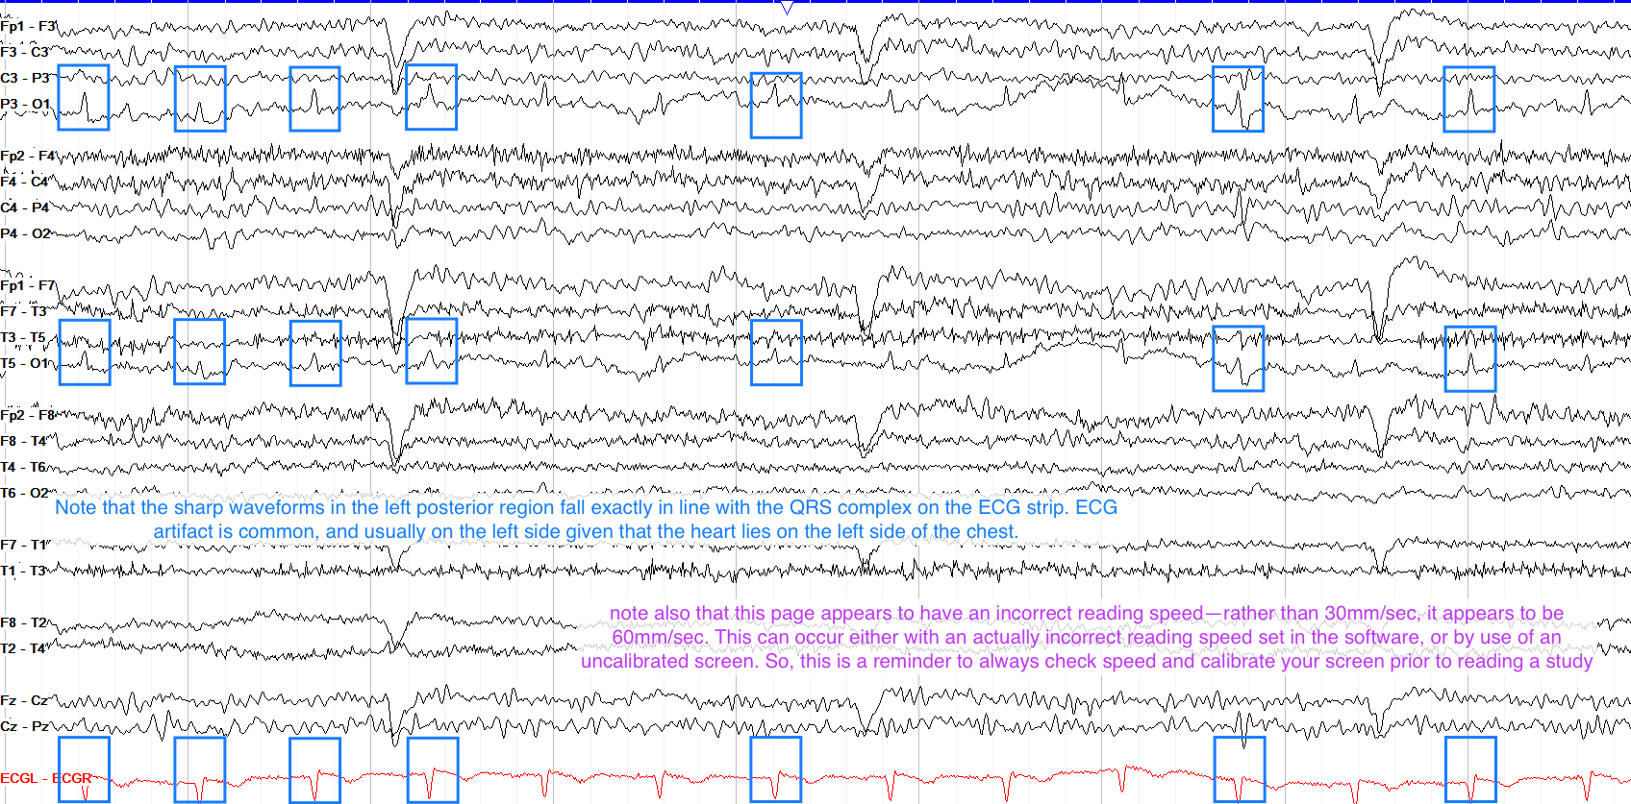
Types of artifacts
Eye blinks
Lateral eye movements
Chewing and tongue artifact
ECG artifact
Electrical artifact
https://www.learningeeg.com/artifacts

Slide 7
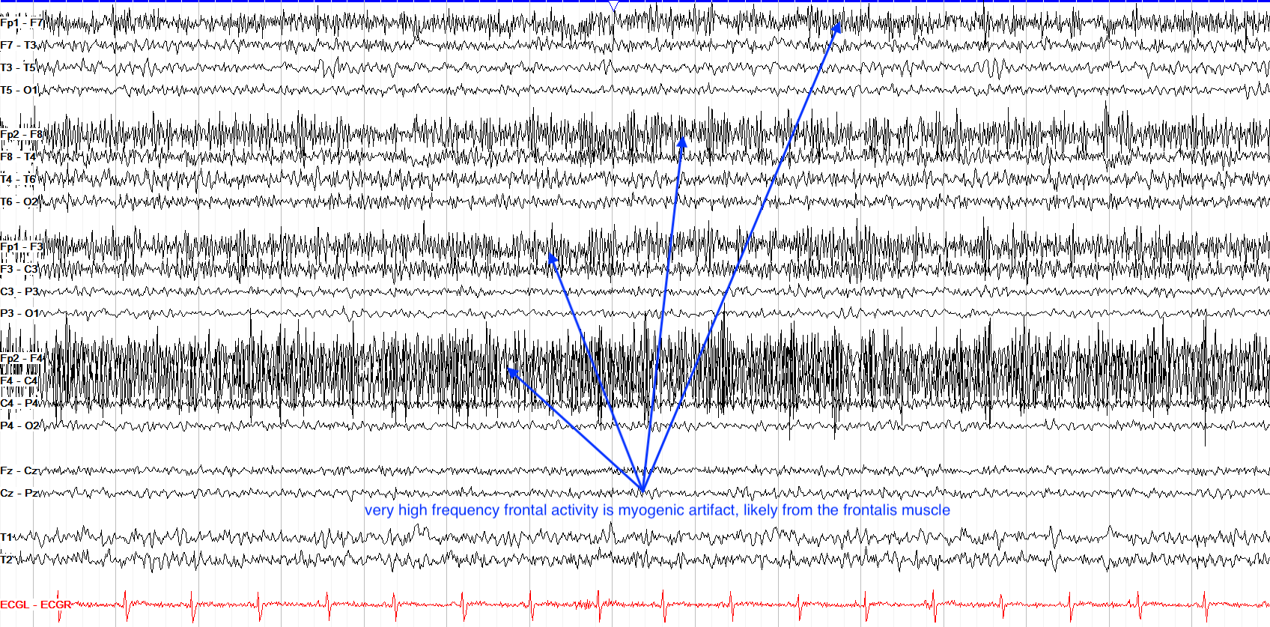
Types of artifacts
Eye blinks
Lateral eye movements
Chewing and tongue artifact
ECG artifact
Electrical artifact
Myogenic artifact
https://www.learningeeg.com/artifacts

Slide 8
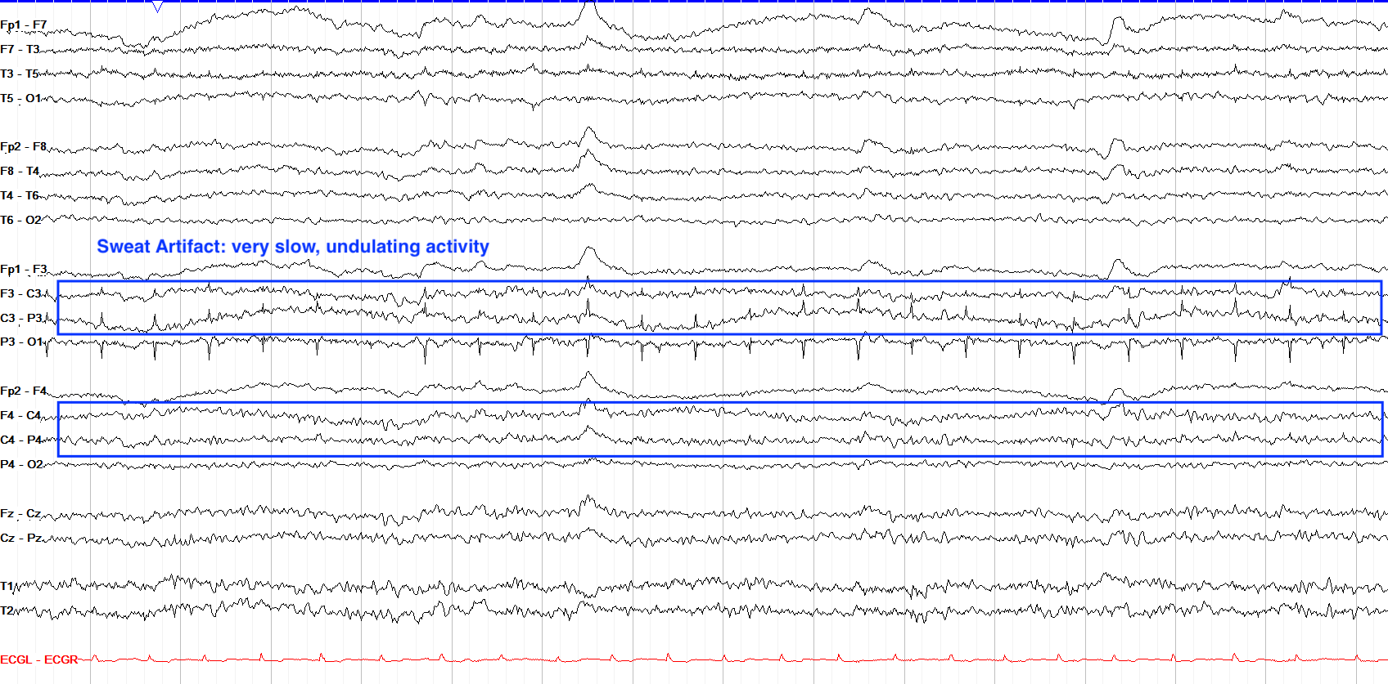
Types of artifacts
Eye blinks
Lateral eye movements
Chewing and tongue
ECG
Electrical
Myogenic
Sweat
https://www.learningeeg.com/artifacts

Slide 9
Approaches
Blind source separation (BSS) methods
Artifact subspace reconstruction (ASR)
Independent component analysis (ICA)
ML/DL
Residual CNN
Autoencoder
UNet
GAN
Transfomer

Slide 10
Approaches
Blind source separation (BSS) methods
Artifact subspace reconstruction (ASR)
Independent component analysis (ICA)
ML/DL
Residual CNN
Autoencoder
UNet
GAN
Transfomer
Use statistical assumptions
Single nonlinear/linear mapping function, might be too simplistic
Not fully automated

Slide 11
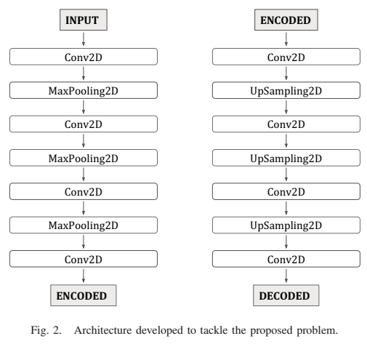
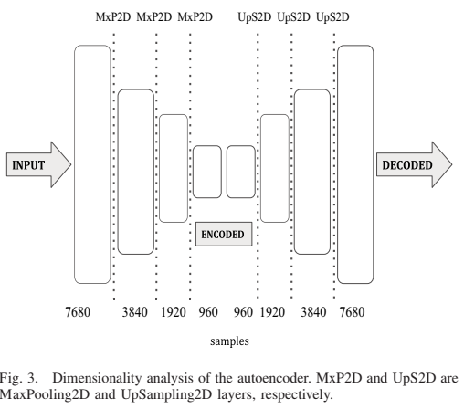
Deep Convolutional Autoencoder (DAE)
F. Lopes et al., "Automatic Electroencephalogram Artifact Removal Using Deep Convolutional Neural Networks," in IEEE Access, vol. 9, pp. 149955-149970, 2021, doi: 10.1109/ACCESS.2021.3125728.

Slide 12
Deep Convolutional Autoencoder (DAE)
Data
19 channels
128 Hz
chunk length 7680 (60 s)
normalization
F. Lopes et al., "Automatic Electroencephalogram Artifact Removal Using Deep Convolutional Neural Networks," in IEEE Access, vol. 9, pp. 149955-149970, 2021, doi: 10.1109/ACCESS.2021.3125728.

Slide 13
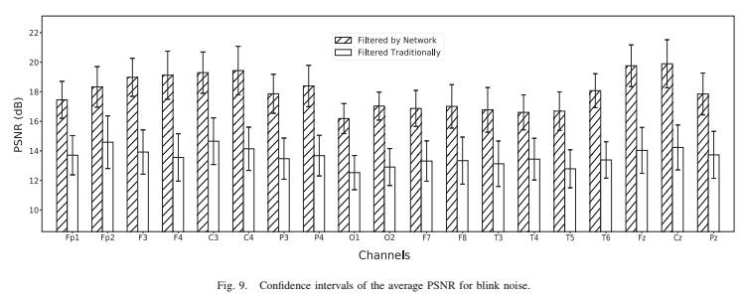
Deep Convolutional Autoencoder (DAE)
F. Lopes et al., "Automatic Electroencephalogram Artifact Removal Using Deep Convolutional Neural Networks," in IEEE Access, vol. 9, pp. 149955-149970, 2021, doi: 10.1109/ACCESS.2021.3125728.

Slide 14
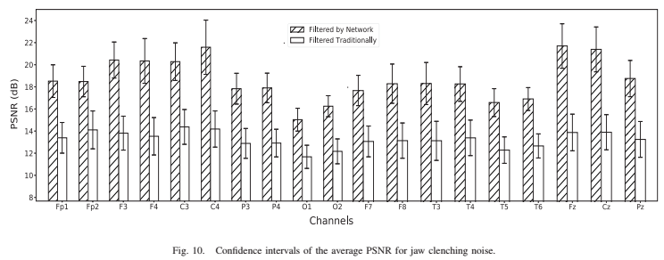
Deep Convolutional Autoencoder (DAE)
F. Lopes et al., "Automatic Electroencephalogram Artifact Removal Using Deep Convolutional Neural Networks," in IEEE Access, vol. 9, pp. 149955-149970, 2021, doi: 10.1109/ACCESS.2021.3125728.

Slide 15
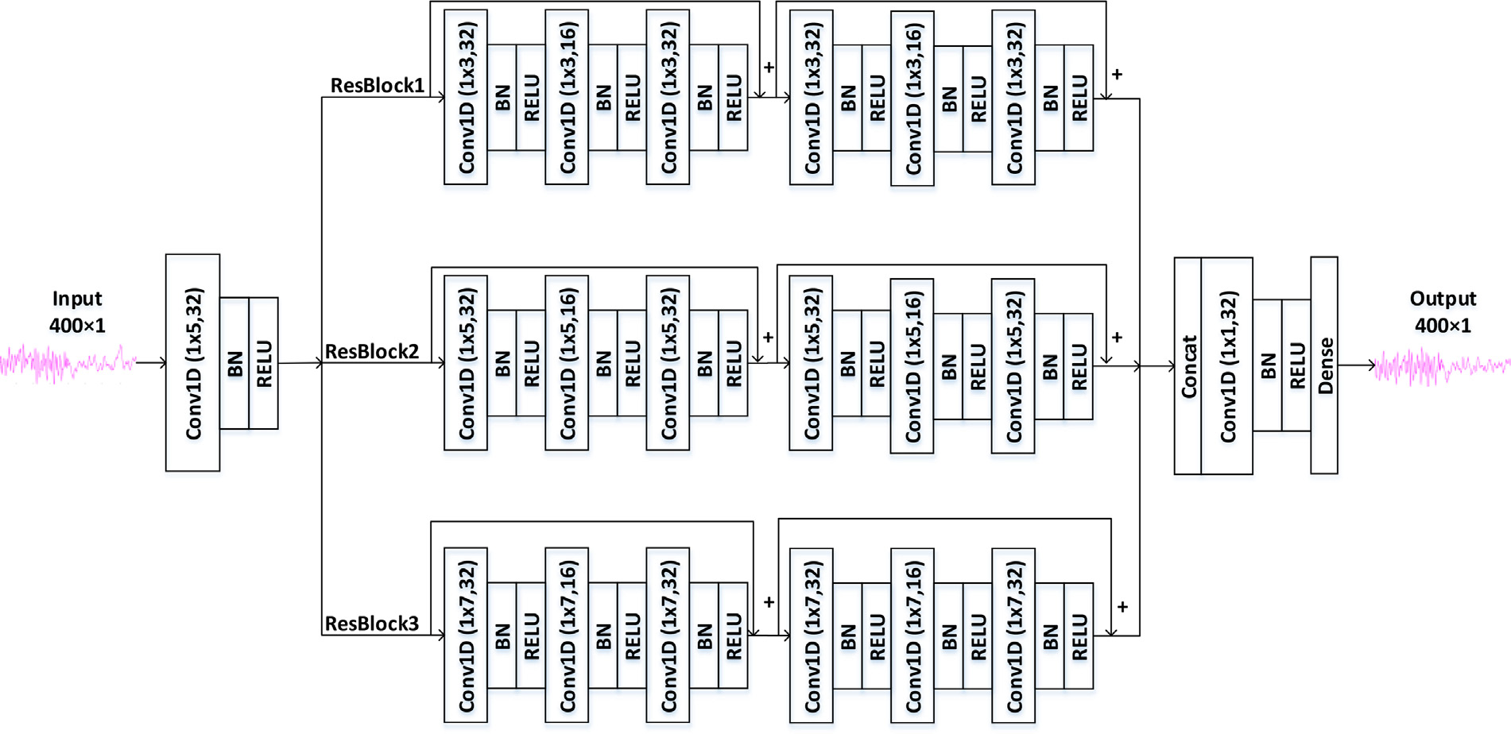
1D-ResCNN
Sun, W., Su, Y., Wu, X., Wu, X., 2020. A novel end-to-end 1D-ResCNN model to remove artifact from EEG signals. Neurocomputing 404, 108–121.

Slide 16
1D-ResCNN
Data
256 Hz
window size of 400, stride 380 (~1.56 s)
normalization
Sun, W., Su, Y., Wu, X., Wu, X., 2020. A novel end-to-end 1D-ResCNN model to remove artifact from EEG signals. Neurocomputing 404, 108–121.

Slide 17
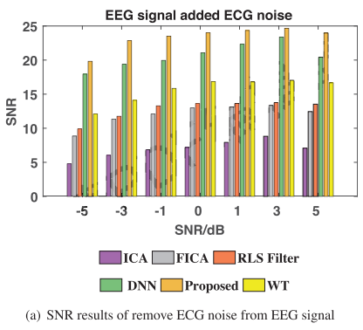
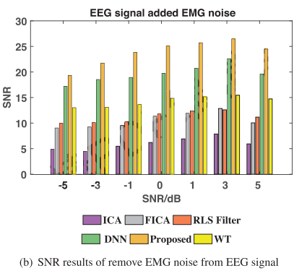
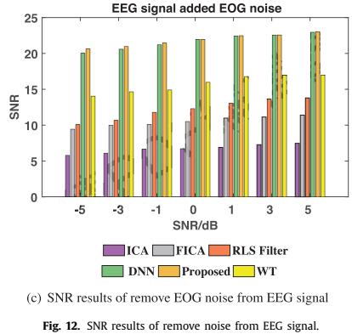
1D-ResCNN
Sun, W., Su, Y., Wu, X., Wu, X., 2020. A novel end-to-end 1D-ResCNN model to remove artifact from EEG signals. Neurocomputing 404, 108–121.

Slide 18
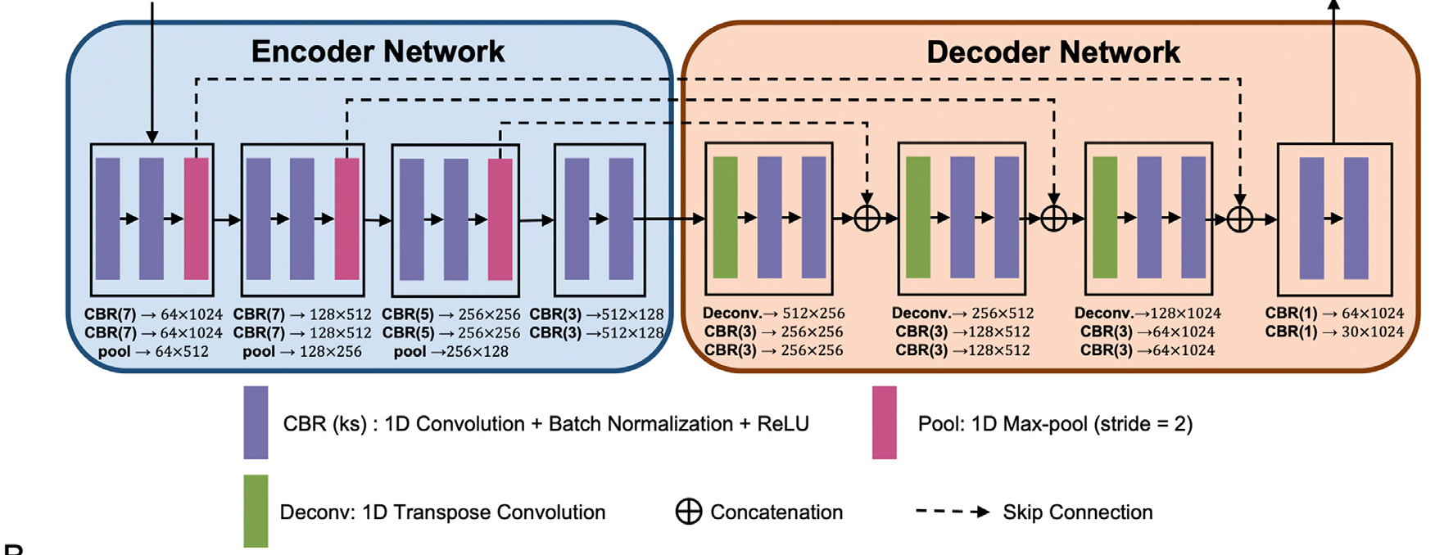
IC-U-Net
Chun-Hsiang Chuang, Kong-Yi Chang, Chih-Sheng Huang, Tzyy-Ping Jung, IC-U-Net: A U-Net-based Denoising Autoencoder Using Mixtures of Independent Components for Automatic EEG Artifact Removal, NeuroImage, Volume 263, 2022, 119586, ISSN 1053-8119,

Slide 19
IC-U-Net
Data
30 channels
256 Hz
chunk length 1024 (4 s)
normalization
Chun-Hsiang Chuang, Kong-Yi Chang, Chih-Sheng Huang, Tzyy-Ping Jung, IC-U-Net: A U-Net-based Denoising Autoencoder Using Mixtures of Independent Components for Automatic EEG Artifact Removal, NeuroImage, Volume 263, 2022, 119586, ISSN 1053-8119,

Slide 20
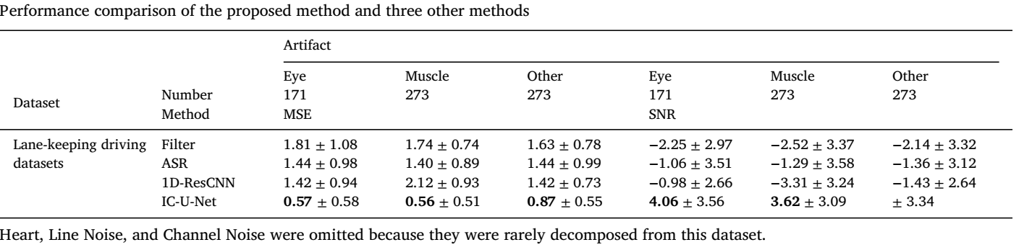
IC-U-Net
Results
Chun-Hsiang Chuang, Kong-Yi Chang, Chih-Sheng Huang, Tzyy-Ping Jung, IC-U-Net: A U-Net-based Denoising Autoencoder Using Mixtures of Independent Components for Automatic EEG Artifact Removal, NeuroImage, Volume 263, 2022, 119586, ISSN 1053-8119,

Slide 21
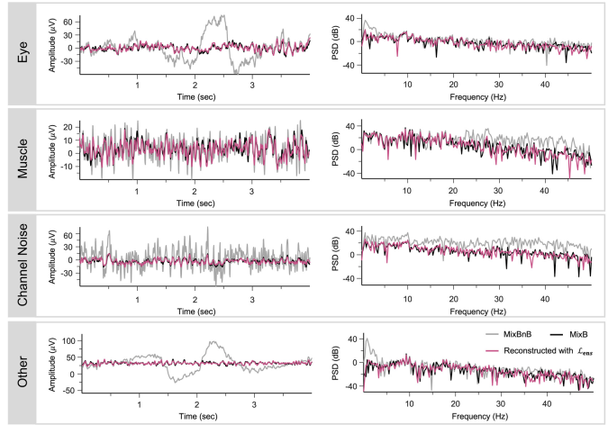
IC-U-Net
Results
Chun-Hsiang Chuang, Kong-Yi Chang, Chih-Sheng Huang, Tzyy-Ping Jung, IC-U-Net: A U-Net-based Denoising Autoencoder Using Mixtures of Independent Components for Automatic EEG Artifact Removal, NeuroImage, Volume 263, 2022, 119586, ISSN 1053-8119,

Slide 22
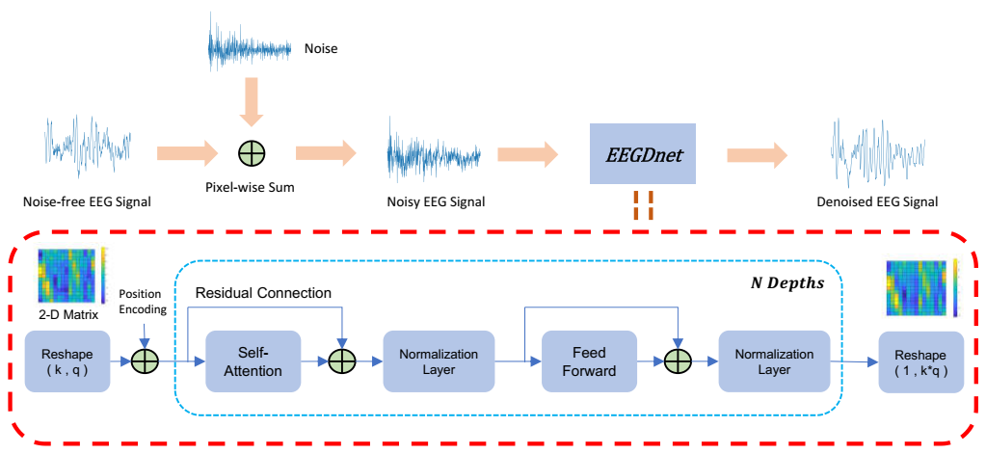
EEGDnet transformer
Yi, Peng & Chen, Kecheng & Ma, Zhaoqi & Zhao, Di & Pu, Xiaorong & Ren, Yazhou. (2021). EEGDnet: Fusing Non-Local and Local Self-Similarity for 1-D EEG Signal Denoising with 2-D Transformer.

Slide 23
EEGDnet transformer
Data
EEGDnet dataset
No channels
256 Hz
epoch length 512 (2 seconds)
4514 EEG epochs
3400 ocular artifact epochs
5598 muscle artifact epochs
Mixed signals are generated via y = x + λn with a uniformly distributed SNR from -7dB to 2d (x10 to dataset size)
Yi, Peng & Chen, Kecheng & Ma, Zhaoqi & Zhao, Di & Pu, Xiaorong & Ren, Yazhou. (2021). EEGDnet: Fusing Non-Local and Local Self-Similarity for 1-D EEG Signal Denoising with 2-D Transformer.

Slide 24
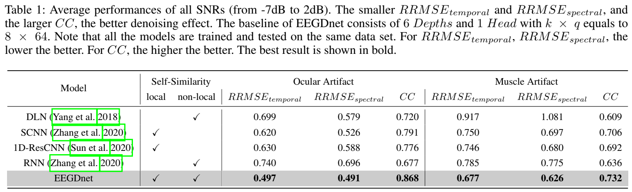
EEGDnet transformer
Yi, Peng & Chen, Kecheng & Ma, Zhaoqi & Zhao, Di & Pu, Xiaorong & Ren, Yazhou. (2021). EEGDnet: Fusing Non-Local and Local Self-Similarity for 1-D EEG Signal Denoising with 2-D Transformer.

Slide 25
Models evaluation

Slide 26
Dataset
Data
EEGDnet dataset
No channels
256 Hz
epoch length 512 (2 seconds)
4514 EEG epochs
3400 ocular artifact epochs
5598 muscle artifact epochs
Mixed signals are generated via y = x + λn with a uniformly distributed SNR from -7dB to 2d (x10 to dataset size)
Zhang, H.; Zhao, M.; Wei, C.; Mantini, D.; Li, Z.; and Liu, Q. 2020. EEGdenoiseNet: A benchmark dataset for deep learning solutions of EEG denoising. arXiv preprint arXiv:2009.11662.

Slide 27
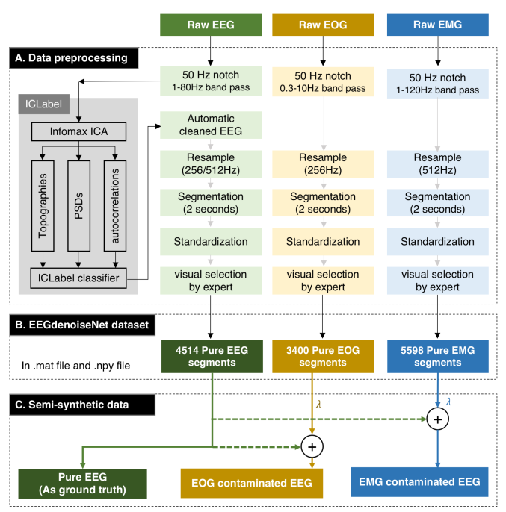
Zhang, H.; Zhao, M.; Wei, C.; Mantini, D.; Li, Z.; and Liu, Q. 2020. EEGdenoiseNet: A benchmark dataset for deep learning solutions of EEG denoising. arXiv preprint arXiv:2009.11662.

Slide 28
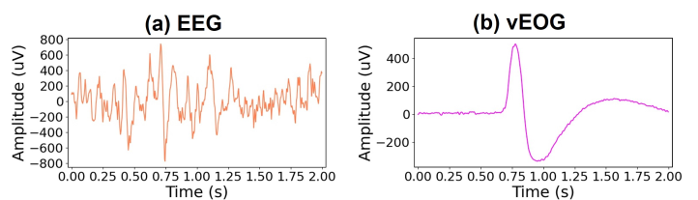
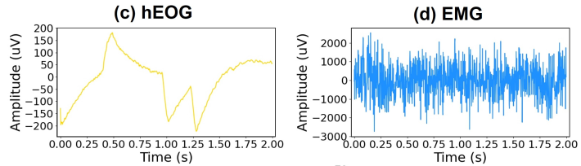
Zhang, H.; Zhao, M.; Wei, C.; Mantini, D.; Li, Z.; and Liu, Q. 2020. EEGdenoiseNet: A benchmark dataset for deep learning solutions of EEG denoising. arXiv preprint arXiv:2009.11662.

Slide 29
Dataset
Dataset
4514 EEG epochs
3400 ocular artifact epochs
5598 muscle artifact epochs
Mixed signals are generated via y = x + λn with a uniformly distributed SNR from -7dB to 2d (x10 to dataset size)
Resulting size of dataset (80/10/10 split):
EOG: train=27200, validation=3400, test=3400
EMG: train=36112, validation=4514, test=4514
Zhang, H.; Zhao, M.; Wei, C.; Mantini, D.; Li, Z.; and Liu, Q. 2020. EEGdenoiseNet: A benchmark dataset for deep learning solutions of EEG denoising. arXiv preprint arXiv:2009.11662.

Slide 30
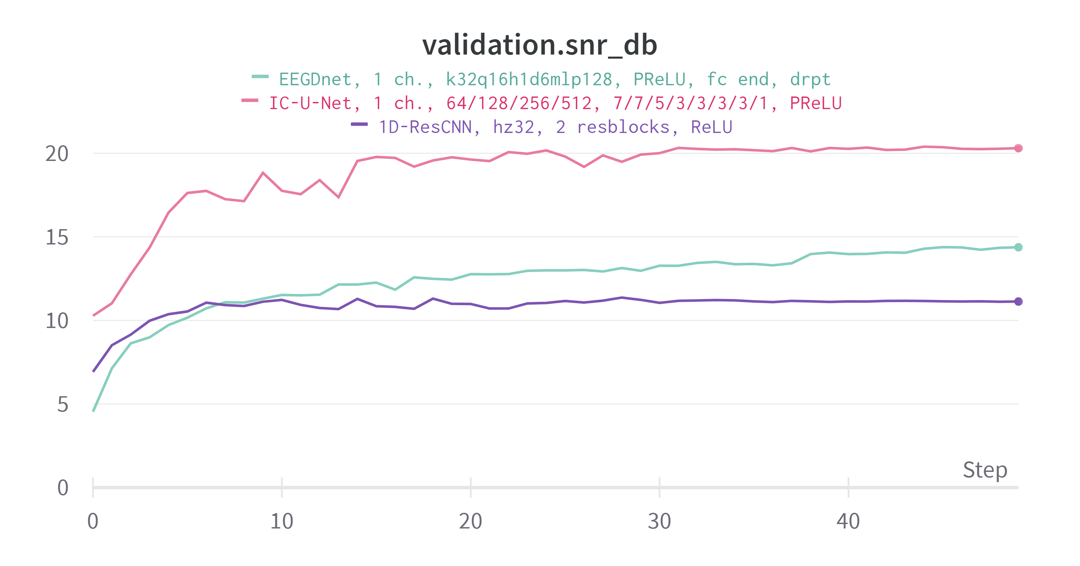
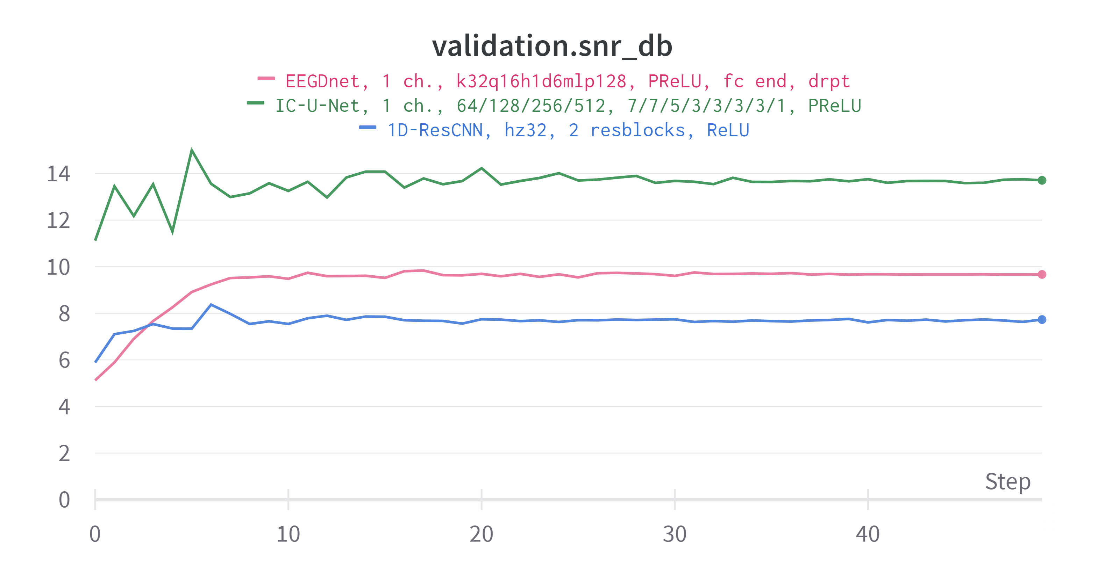
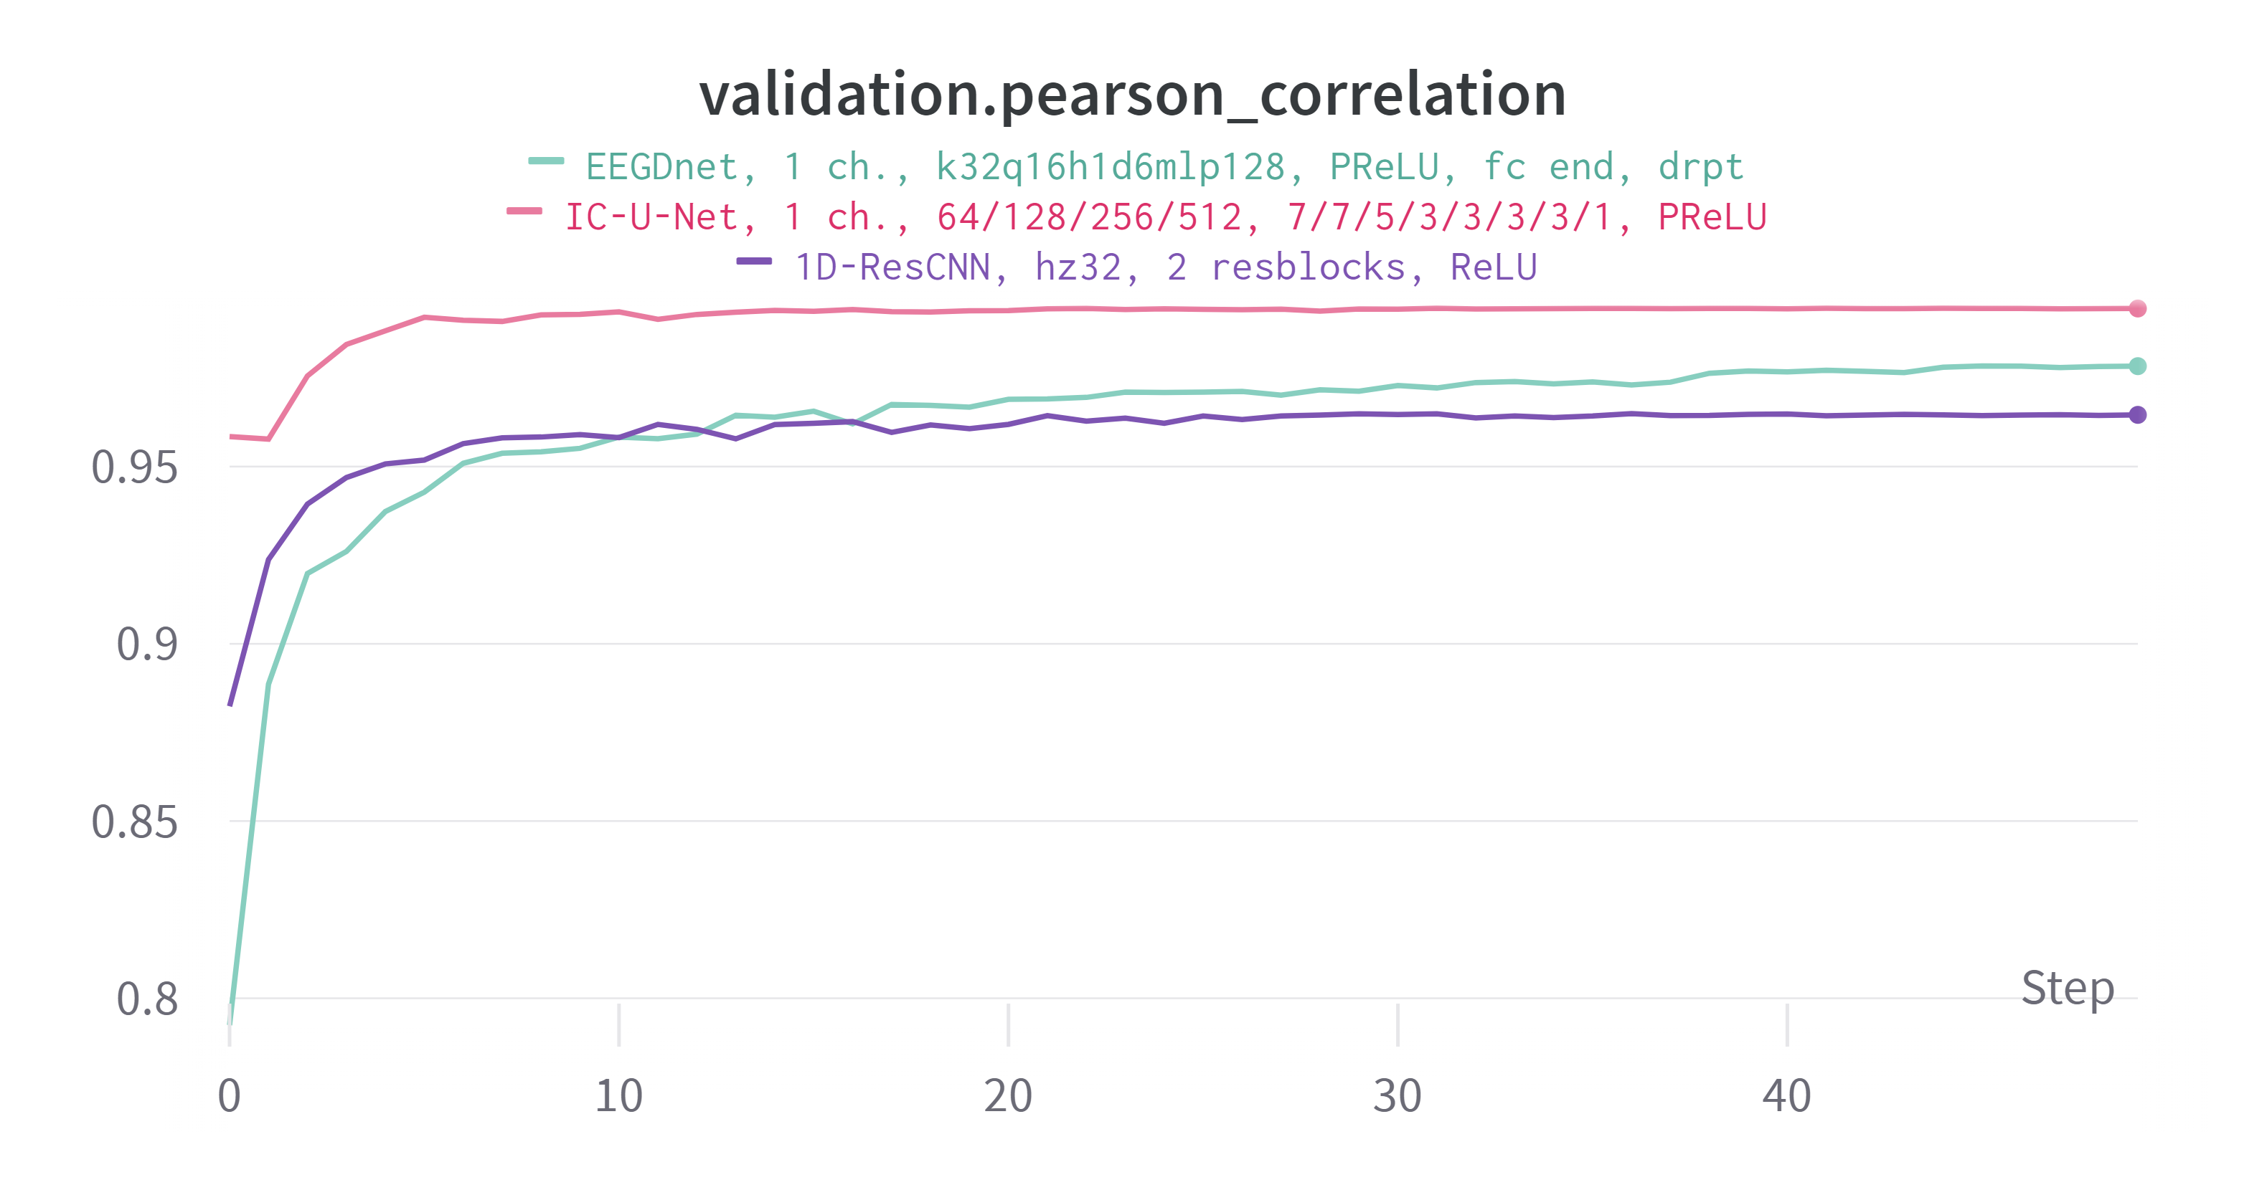
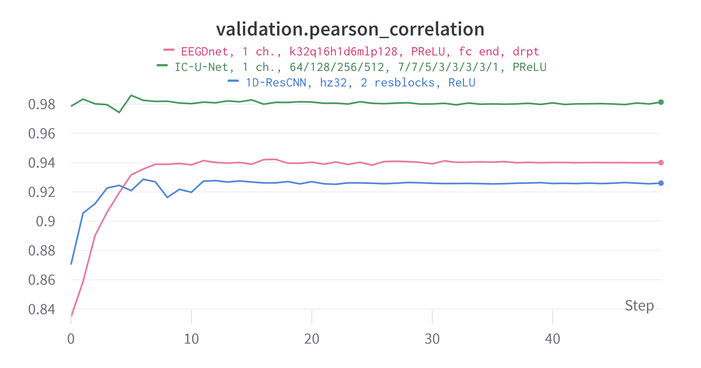
EOG
EMG

Slide 31
Results
 | EOG MSE | EOG SNR, db | EOG CC | EMG MSE | EMG SNR, db | EMG CC
1D-ResCNN | 40.643 | 11.405 | 0.965 | 78.022 | 8.369 | 0.929
IC-U-Net | 5.791 | 20.523 | 0.995 | 17.296 | 14.947 | 0.986
EEGDnet transformer | 22.236 | 14.467 | 0.979 | 57.739 | 9.861 | 0.943

Slide 32
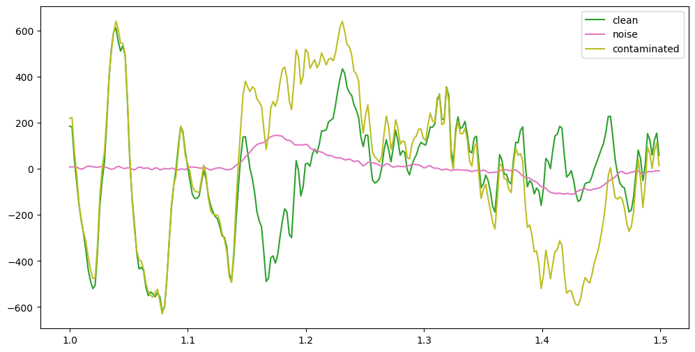
EOG example

Slide 33
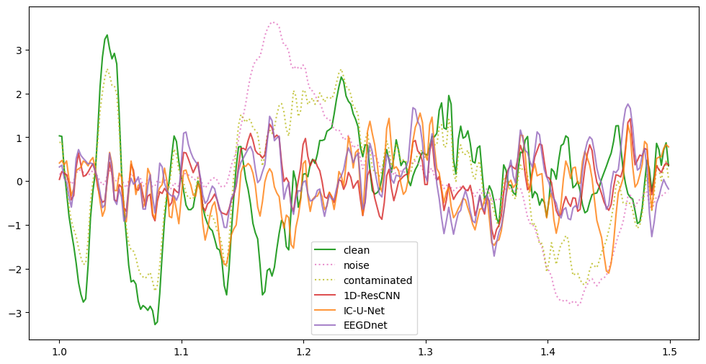
EOG example

Slide 34
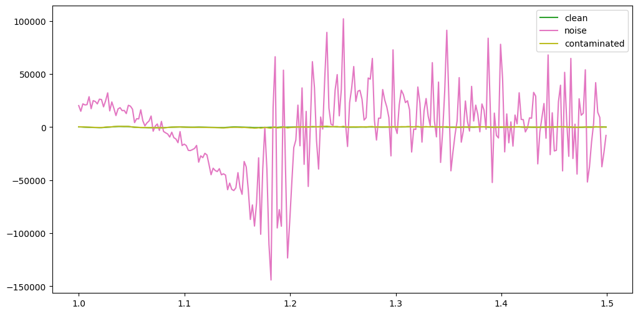
EMG example

Slide 35
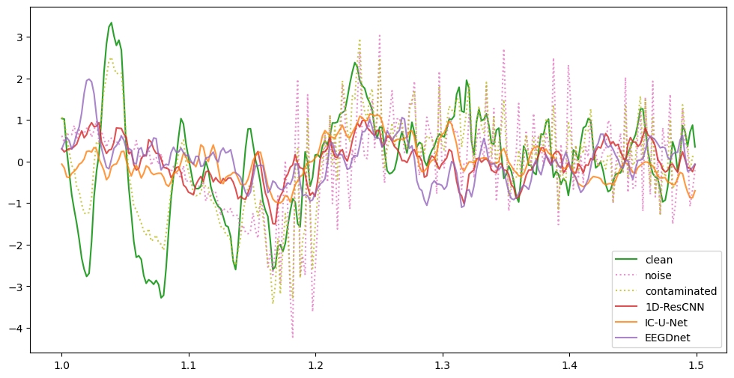
EMG example

Slide 36
Amount of parameters
model | trainable | total
1D-ResCNN | 325891 | 325891
IC-U-Net | 2777943 | 2777943
EEGDnet transformer | 675398 | 675398

Slide 37
Conclusion
IC-U-Net outperformed 1D-ResCNN and EEGDnet transformer architectures in training during 50 epochs;
There is a lack of public dataset containing information about channels;
Тone of the considered models use relationships between channels in their architecture, which can be useful.

Slide 38
Training
batch size: 128
optimizer: AdamW(lr=1e-3)
scheduler: ReduceLROnPlateau(factor=0.5, patience=3)
number of epochs: 50

